Slide 1


FOOD DELIVERY SYSTEM
RNS INSTITUTE OF TECHNOLOGY
BENGALURU - 98
DEPARTMENT OF INFORMATION SCIENCE & ENGINEERING
DBMS MINI PROJECT SEMINAR
By
AMULYA BHANDE MOHANAPRIYA.A
1RN17IS011 1RN17IS057
Under the guidance of
FACULTY INCHARGE LAB INCHARGE
Mrs.Vinutha.G.K Mr. Rajkumar.R
Assistant Professor, Assistant Professor,
Department of ISE, RNSIT

Slide 2
AGENDA
Abstract
Introduction
Front end and Back end tools
ER-Diagram
ER to Schema Mapping
Schema Diagram
Tables description with Normalization
Stored Procedures and Triggers
Results
Snapshots
Applications
Conclusion
References
Department of ISE, RNSIT

Slide 3
ABSTRACT
The purpose of this project is to develop an Online Food Ordering System. It is a system that enables customer to place their order online at any time and any place. The reason to develop the system is due to the issues facing by the food industry.
Beside that, it provides a user-friendly web pages and effective advertising medium to the new product of the online food restaurant to the customer with cheaper cost. This system also provides a feedback system
For more secured ordering separate accounts are maintained for each user by providing them an ID and a password. The structured methodologies have been chosen to develop the Online Food Ordering System.
Department of ISE, RNSIT

Slide 4
INTRODUCTION
The online food ordering system sets up a food menu online and customers can easily place the order as per they like. Also with a food menu, online customers can easily track the orders. The management maintains customers database, and improve food delivery service. The Restaurant management systems motivates us to develop the system.
The proposed system is designed to avoid users doing fatal errors and inappropriate action. The major attributes that will give input to the dataset are: name, address, email-Id, mobile no, other personal related values, etc. The output will include user/customer’s Order, Bill, Feedback and Payment options
Department of ISE, RNSIT

Slide 5
The reason why to choose this project is the idea behind project that is to solve problem of people which they are facing when they shift to different city. The system is not only for user but also for provider who provides food service.
This system is for making efficient communication between consumer and producer of the food system which will then leads to the ideal and effective system.
Department of ISE, RNSIT

Slide 6
FRONT END AND BACK END TOOLS
HTML: Hypertext Markup Language (HTML) is the standard markup language for documents designed to be displayed in a web browser. It can be assisted by technologies such as Cascading Style Sheets (CSS) and scripting languages such as JavaScript.
CSS : Cascading Style Sheets (CSS) is a style sheet language used to describe the presentation of a document written in HTML or XML. Create attractive Layout.
JavaScript: JavaScript has curly-bracket syntax, dynamic typing, prototype-based object-orientation, and first-class functions. Alongside HTML and CSS. JavaScript is one of the core technologies of the World Wide Web.
Department of ISE, RNSIT

Slide 7
PHP: Hypertext Pre-processor (PHP) is a technology that allows software developers to create dynamically generated web pages, in HTML, XML, or other document types, as per client request. PHP is open source software.
MySQL: MySql is a database, widely used for accessing querying, updating, and managing data in databasesSQL is a small, fast and embeddable database where the database engine and the interface are combined into a single library. It also has the ability to store all the data in a single file. All the SQL statements start with any of the keywords like select, create, update, insert, delete, alter, drop etc., and all the statements end with a semicolon (;).
Department of ISE, RNSIT

Slide 8
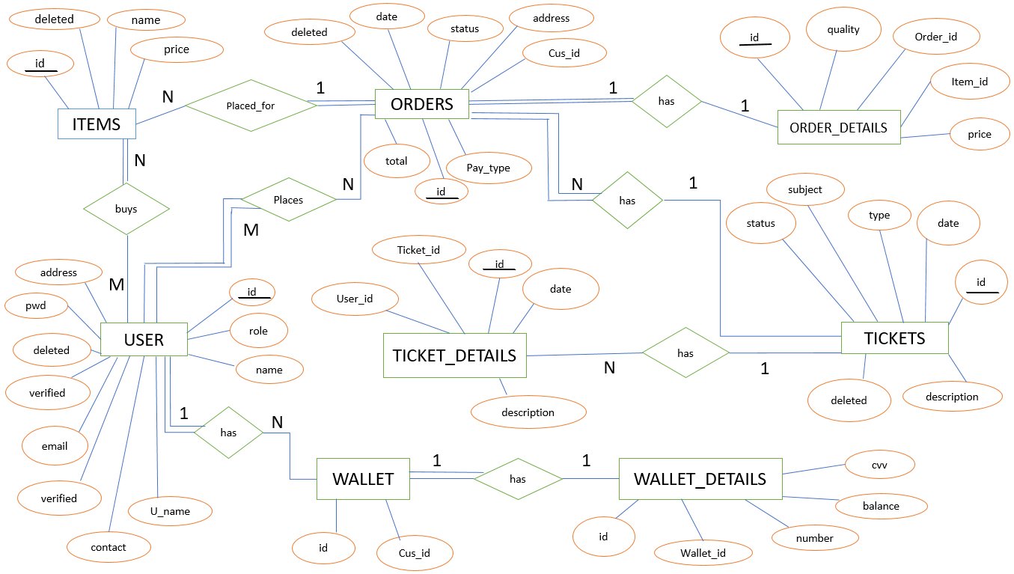
ER-DIAGRAM
Department of ISE, RNSIT

Slide 9
ER TO SCHEMA MAPPING
ITEMS: ORDERS is of cardinality N: 1 as one order can have more than one item and therefore connected via ‘Placed_for’ relationship. There is total participation of ORDERS and ITEMS has partial participation as:
  An order cannot exist without having a particular item to take it.
  An item can exist without orders being taken.
ORDERS: ORDER_DETAILS is of cardinality 1: 1 as 1 order can be placed only once. They are connected via the relationship ‘Has’. There is total participation of ORDERS and ORDER_DETAILS has partial participation as:
  An order cannot exist without having a particular details to take it.
  An order_detail can exist without orders being taken.
TICKETS: ORDERS is of cardinality 1: N as 1 ticket can have N orders under it. They are connected via the relationship ‘Has’. There is total participation of ORDERS and partial participation of TICKETS as:
  An order may or may not require ticket.
  A ticket cannot exist without an order being placed.
Department of ISE, RNSIT

Slide 10
TICKETS: TICKET_DETAILS is of cardinality 1: N as 1 ticket can have N ticket details. They are connected via the relationship ‘Has’. There is total participation of TICKETS and partial participation of TICKET_DETAILS:
  A ticket_detail can exist without a ticket being written.
  A ticket needs ticket_details to be filled.
ORDER: USER is of cardinality N: M as N number of orders can be placed by M number of users. They are connected via relationship ‘Places’. There is total participation of ORDERS and partial participation of USERS as:
  A user can exist without placing orders.
  An order does not exist without the existence of a user to place for.
ITEMS: USERS is of cardinality N: M as N number of items can be bought by M number of users while ordering food. They are connected by relationship ‘Buys’. There is no total participation of both entities as:
  A user can exist without buying any food item.
  An item can exist without any user buying that particular item.
Department of ISE, RNSIT

Slide 11
USER: WALLET is of cardinality 1: 1 as 1 user can have one wallet. Also each wallet can have only 1 user. They are connected via the relationship ‘Has’. There is total participation of both entities as:
  A user cannot exist without wallet.
  A wallet cannot exist without a user.
WALLET: WALLET_DETAILS is of cardinality 1:1 as 1 wallet can have only one unique set of details. Also a wallet_detail can be synced to only one wallet. The relationship is ‘Has’. There is total participation of both entities as:
  A wallet cannot exist without wallet_details.
  Wallet_details need not exist until a wallet is present.
Department of ISE, RNSIT

Slide 12
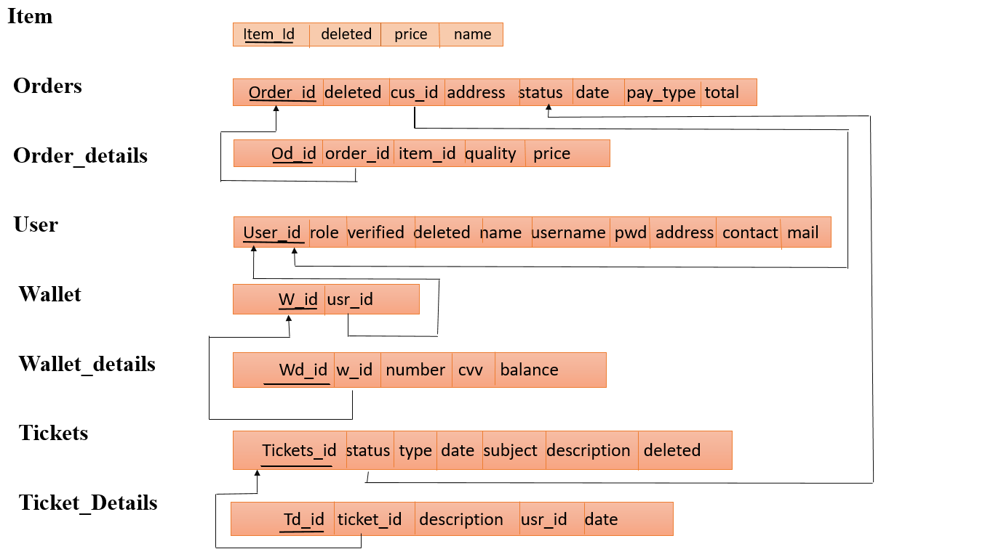
SCHEMA-DIAGRAM
Department of ISE, RNSIT

Slide 13
TABLES
ITEMS
Column | Type | Null | Key | Default
id | int(11) | No | Primary
name | varchar(100) | No
price | int(11) | No
deleted | tinyint(4) | No |  | 0
Department of ISE, RNSIT

Slide 14
ORDERS
Column | Type | Null | Key | Default
id | int(11) | No | primary
customer_id | int(11) | No
address | varchar(300) | No
description | varchar(300) | No
date | datetime | No |  | CURRENT_TIMESTAMP
payment_type | varchar(16) | No |  | Wallet
total | int(11) | No
status | varchar(25) | No |  | Yet to be delivered
deleted | tinyint(4) | No |  | 0
ORDER_DETAILS
Column | Type | Null | Key | Default
id | int(11) | No | primary
order_id | int(11) | No
item_id | int(11) | No
quantity | int(11) | No
price | int(11) | No
Department of ISE, RNSIT

Slide 15
TICKETS
Column | Type | Null | Key | Default
id | int(11) | No | primary
poster_id | int(11) | No
subject | varchar(100) | No
description | varchar(3000) | No
status | varchar(8) | No |  | Open
type | varchar(30) | No |  | Others
date | datetime | No |  | CURRENT_TIMESTAMP
deleted | tinyint(4) | No |  | 0
TICKET_DETAILS
Column | Type | Null | Key | Default
id | int(11) | No | primary
ticket_id | int(11) | No
user_id | int(11) | No
description | varchar(1000) | No
date | datetime | No |  | CURRENT_TIMESTAMP
Department of ISE, RNSIT

Slide 16
USERS
Column | Type | Null | Key | Default
id | int(11) | No | primary
role | varchar(15) | No |  | Customer
name | varchar(15) | No
username | varchar(10) | No
email | varchar(35) | Yes |  | NULL
address | varchar(300) | Yes |  | NULL
contact | bigint(11) | No
verified | tinyint(1) | No |  | 0
deleted | tinyint(4) | No |  | 0
Department of ISE, RNSIT

Slide 17
WALLET
Column | Type | Null | Key | Default
id | int(11) | No | primary
customer_id | int(11) | No
WALLET_DETAILS
Column | Type | Null | Key | Default
id | int(11) | No | primary
wallet_id | int(11) | No
number | varchar(16) | No
cvv | int(3) | No
balance | int(11) | No |  | 2000
Department of ISE, RNSIT

Slide 18
PROCEDURES AND TRIGGERS
Stored Procedure
CREATE DEFINER=`root`@`localhost` PROCEDURE `select_order` (IN `user_id` INT, IN `stat` VARCHAR)
BEGIN
SELECT * FROM orders
WHERE customer_id = user_id
AND status LIKE stat
END$$
DELIMITER ;
Department of ISE, RNSIT

Slide 19
Trigger
CREATE TRIGGER cancel_order_tri
AFTER UPDATE on orders
BEGIN
IF NEW.payment_type = 'Wallet' THEN
UPDATE wallet_details SET balance = balance + NEW.total
WHERE wallet_id = (SELECT id FROM wallet w
WHERE NEW.customer_id = w.customer_id);
END IF;
END
Department of ISE, RNSIT

Slide 20
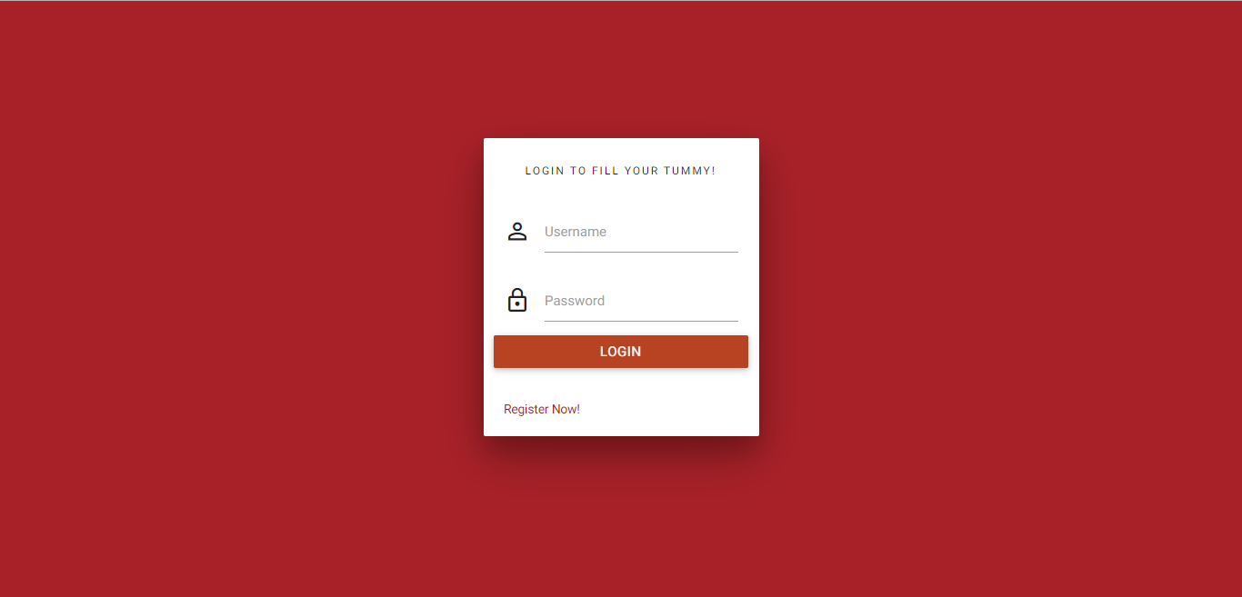
SNAPSHOTS
shows the login form of the Food Delivery application.
Department of ISE, RNSIT

Slide 21
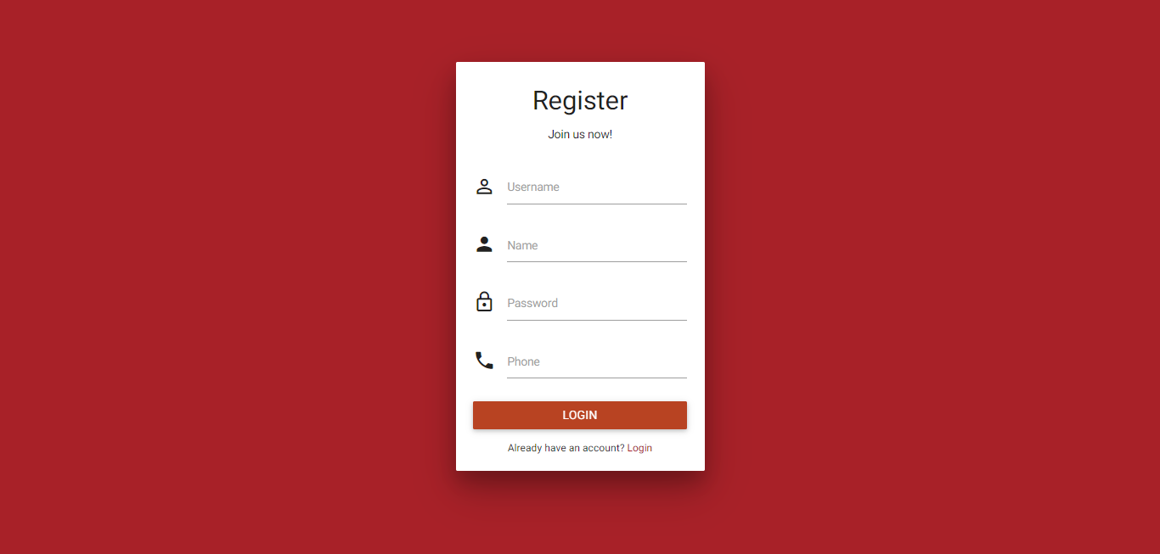
.
Registration Page
shows the registration form of Food Delivery application. Suppose a new customer wants to order food then he/she must have a login ID
.
Department of ISE, RNSIT

Slide 22
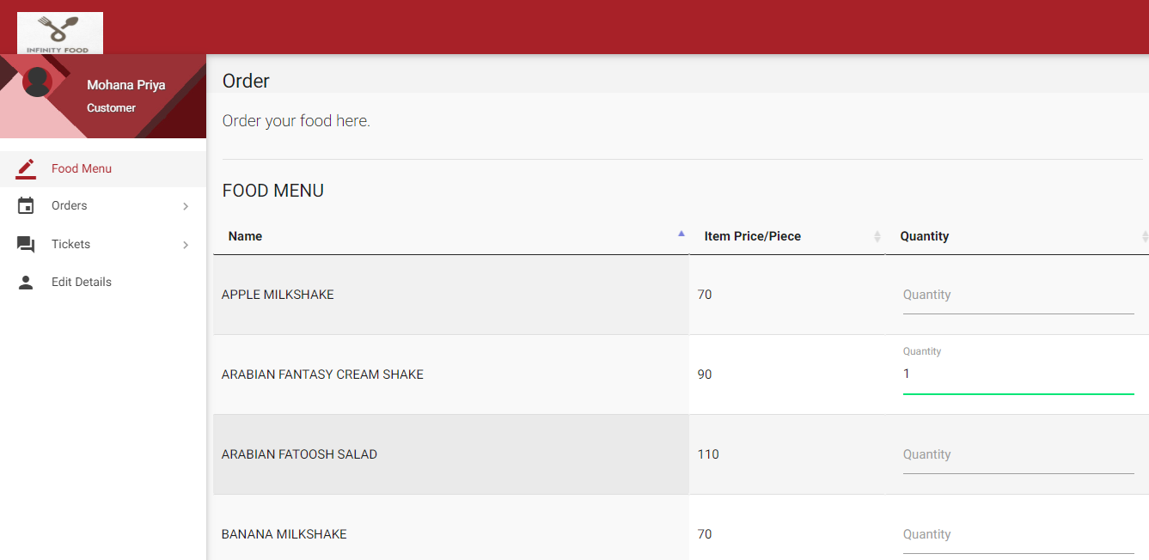
Food Menu
shows the huge variety of food available. We can mention the quantity in the quantity field.
Department of ISE, RNSIT

Slide 23
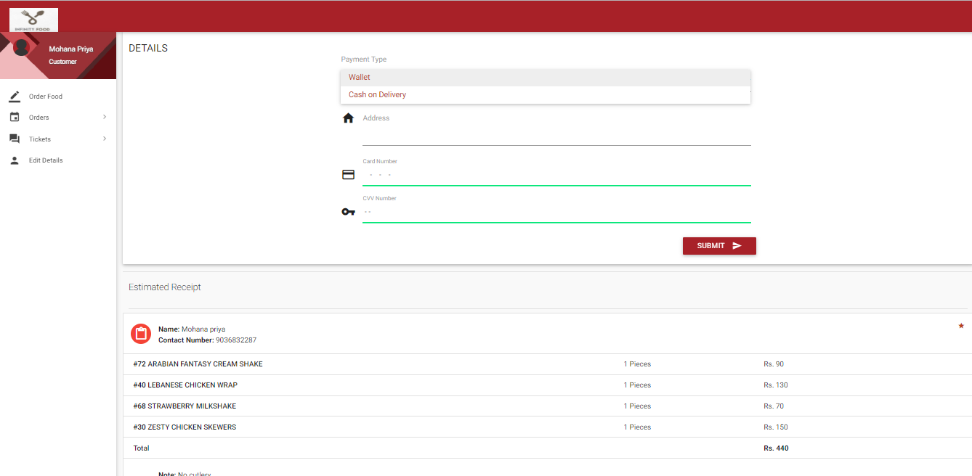
Delivery and Payment Details
shows the Delivery and Payment Details page. The customer can choose to pay from the wallet or COD. Customer should also enter the address to which the food should be delivered.
Department of ISE, RNSIT

Slide 24
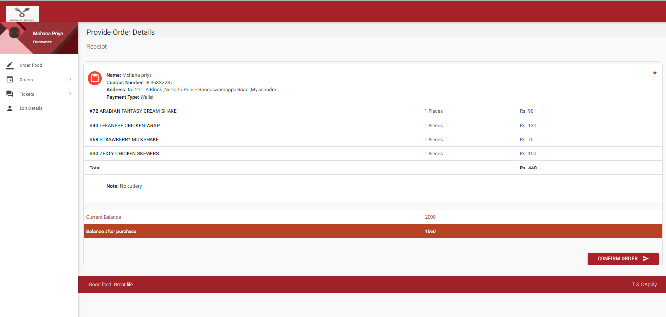
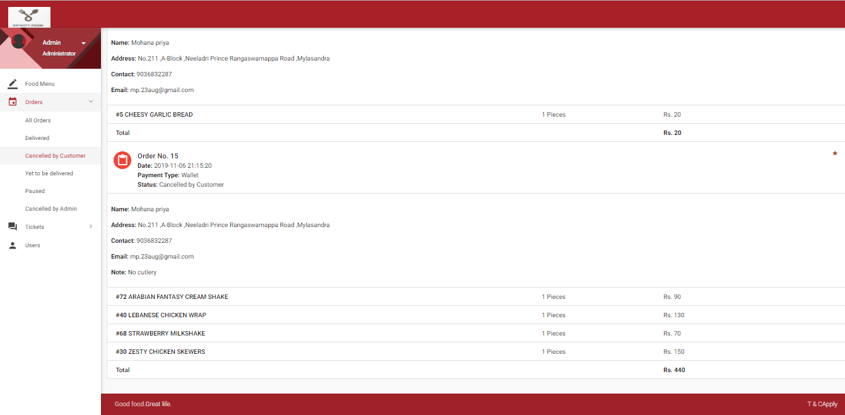
Confirm Order
All Orders
Department of ISE, RNSIT

Slide 25
View Orders cancelled by Customers
shows all the orders cancelled by the customers.
Department of ISE, RNSIT

Slide 26
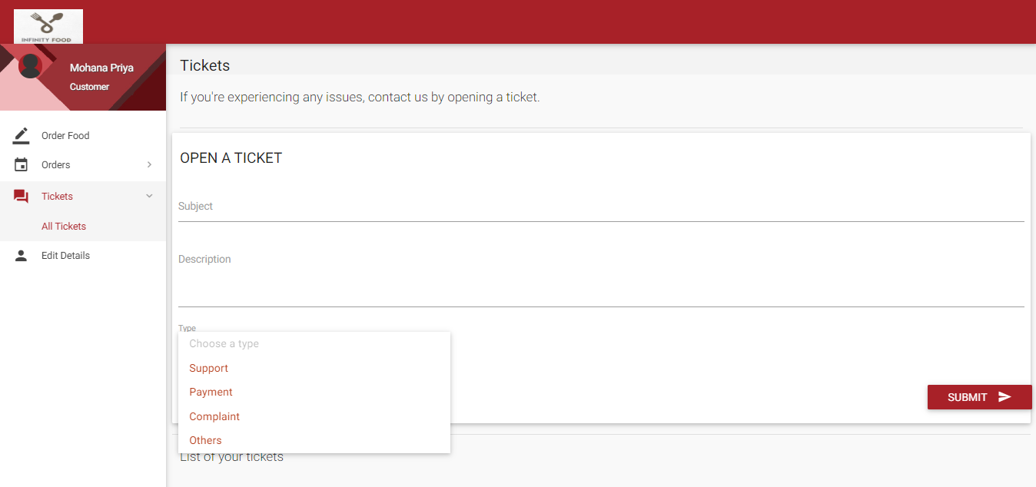
Tickets Page
shows the Ticket page, it’s the page where the customer can write to the administrator if he/she is facing any sort of inconvenience in service
Department of ISE, RNSIT

Slide 27
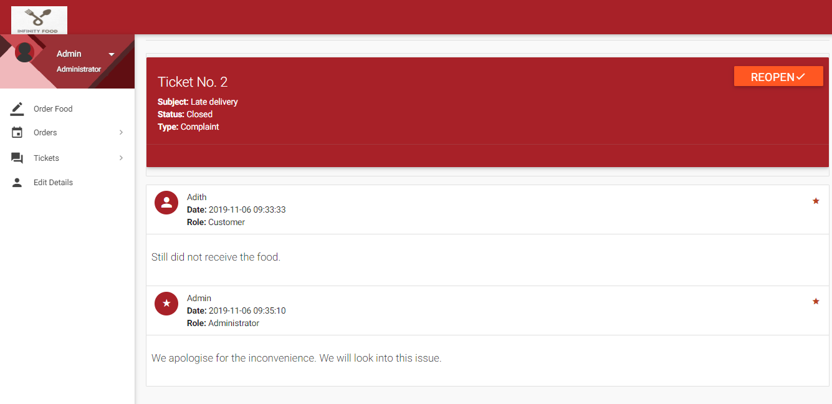
Reply to ticket
shows the page where the Admin can reply to the customer’s ticket.
Department of ISE, RNSIT

Slide 28
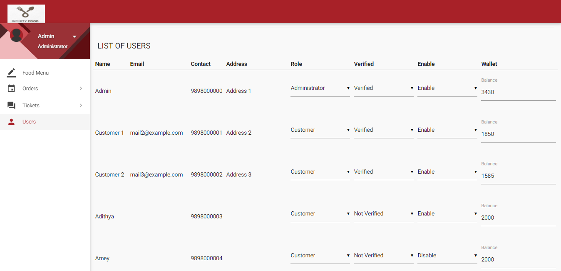
List of Users
16 shows the list of users who have registered along with their login credentials. The Admin can modify the credentials that is he can make the customer ‘Verified’ which means he is capable of making Cash on delivery payment
Department of ISE, RNSIT

Slide 29
APPLICATIONS
Create/ Increase a brand value of your restaurant by creating an app.
By creating an app or website your customers can place an order for 24/7,
In short more sales & profit.
Online menu is more straightforward to manage.
Get reviews and ratings from customers, improve your services.
Customers can track delivery, pay online, make a pre-order, no more waiting.
Easy to maintain a customer relationship.
Inform your customer about the new food items easily, save marketing cost.
Department of ISE, RNSIT

Slide 30
CONCLUSION
Our project is a an attempt to make the structure and working of any online food delivery simpler and user-friendly. In this scenario, all the undertakings of an Online Food Delivery System are achieved in a constructive manner.
It helps customer in making order easily; The Food website application made for restaurant and mess can help restaurant and mess in receiving orders and modifying its data and it is also made for admin so that it helps admin in controlling all the Food system.
Give the right guidance and support; we hope to enhance its applications and availability
Department of ISE, RNSIT

Slide 31
FUTURE ENHANCEMENT
Customize orders: Allow customers to customize food orders.
Enhance User Interface by adding more user interactive features. Provide deals and promotional Offer details to home page.
Payment options: Add different payment options such as PayPal, Gift Cards etc.
Delivery options: Add delivery option
Order Ready Notification: Send an Order Ready notification to customer.
Restaurant Locator: Allow to find and choose a nearby restaurant.
Department of ISE, RNSIT

Slide 32
REFERENCES
Raghu Ramakrishnan and Johannes Gehrke, Database Management Systems, McGREW HILL, 3rd Edition.
Ramez Elmasri and Shamkant B. Navathe, Fundamentals of Database Systems, Pearson, 7th Edition.
Herbert Schildt, Java: The Complete Reference, McGRAW HILL, 7th Edition.
www.stackoverflow.com
www.mysql.com/doc
https://docs.microsoft.com
https://www.geeksforgeeks.org
Department of ISE, RNSIT

